Slide 1




we would 💚 to green your space 🌿

Slide 2


Brand
overview
Naturoofs is a pioneering company based in Cairo, Egypt, dedicated to transforming urban spaces through innovative rooftop and balcony gardening solutions.

Slide 3


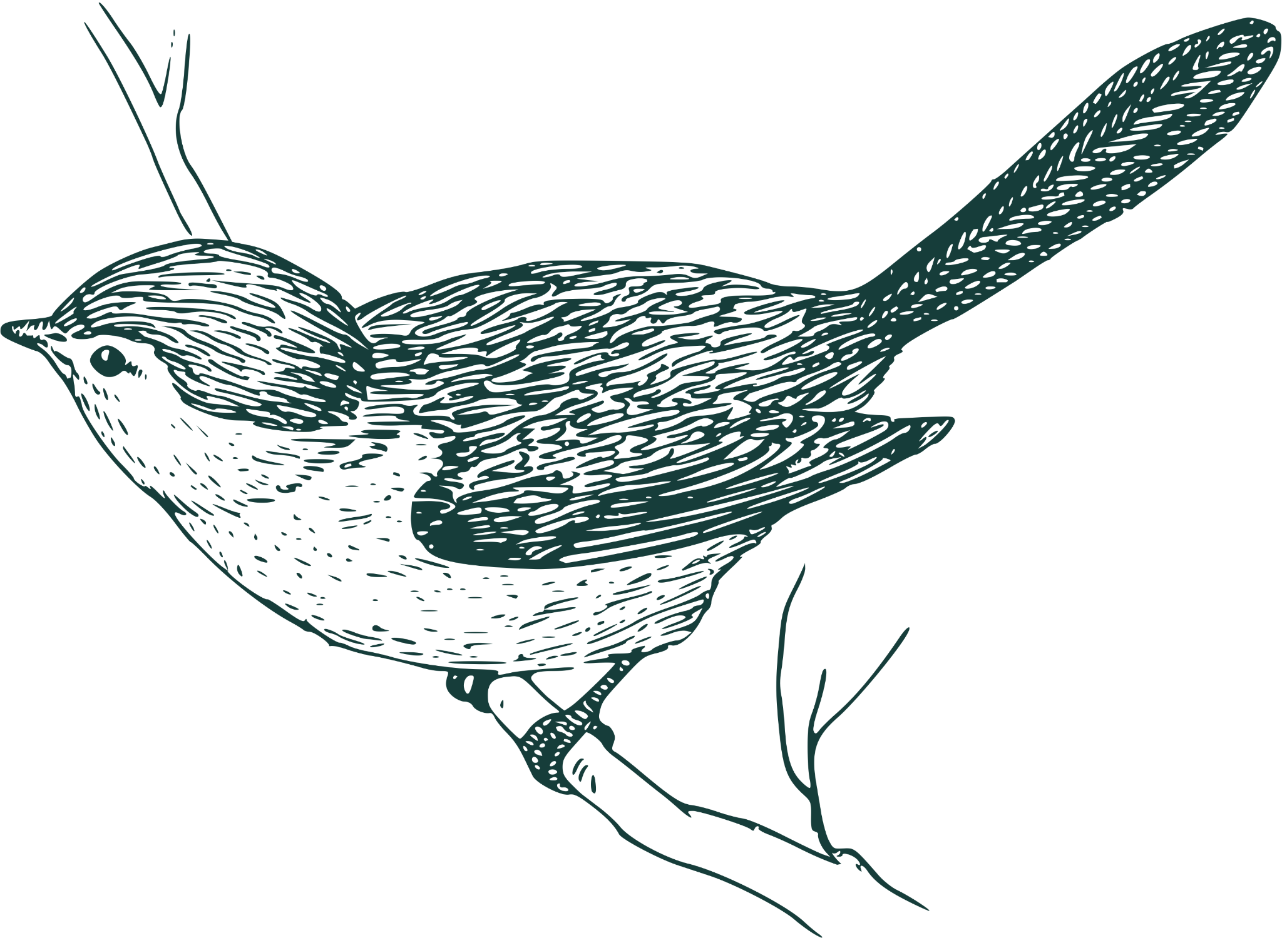
Vision
Our Core Values:
To become the leading provider of rooftop and balcony gardening solutions in Egypt, contributing to greener, healthier, and more beautiful urban environments.
We believe in the power of nature and green spaces to transform and enrich urban living.

Slide 5




S Experienced team. Tailored solutions for each client. Strong commitment to eco-friendly practices. Experienced social media team. Free consultation Cross platform easy navigation website The team members are young and enthusiastic. | W Low marketing budget new social media pages Potential constraints in manpower and financial resources. Limited brand recognition in the early stages.
O Growing market Increasing interest in sustainable living and urban gardening. - Potential collaborations with local governments and environmental organizations. - Innovations in gardening technology and materials. - Opportunities to engage with local communities. Health awareness healthy aesthetic Lifestyle Boycott to foreign products. | T Economic downturns affecting discretionary spending. Emerging competitors in the urban gardening market. Potential changes in building codes and regulations. Low price competitor. Well-known/established competitors Importation and customs competitors strong competitive

Slide 6
Marketing objectives for the first year
Increase Brand Awareness: Grow social media following by 50% and website traffic by 30% over the next 6 months.
Generate Leads: Acquire 100 new leads per month through digital marketing efforts.
Drive Conversions: Achieve a 10% conversion rate from website visitors to consultations.
Customer Retention: Maintain a customer satisfaction score of 90% or higher and achieve an 80% customer retention rate.
Financial objectives for the first year
Sell 100 of the decoration packages per month for an income starting150000 LE.
Sell 150 of the herbs and the leafy plants per month for an income starting75000 LE
Sell 100 0f the vegetables and the fruits packages per month for an income starting100000 LE
Sell 300 of the typical and comprehensive packages per month for an income starting 600000 LE

Slide 7

Targeting
Focus on middle to upper-middle-class homeowners aged 20-55, with a college education and disposable income.
Who lives in Urban areas in Egypt, particularly Cairo, Giza, and new cities.
Value Sustainability, environmental responsibility, healthy living.
And Interests in Gardening, cooking, interior design, community activities and home improvement.

Slide 8
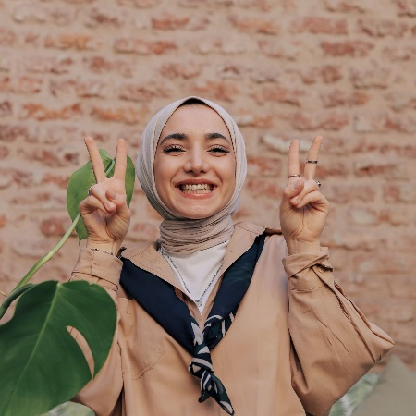
Name: Sarah El-Masry
Age: 30
Occupation: Marketing Manager
Location: Cairo, Egypt
Income: EGP 150,000 per year
Family Status: Married with two children
Education: Bachelor’s degree in Business Administration
Background:
Sarah lives in a mid-sized apartment in Cairo with her family.
She has a busy professional life but values spending quality time with her family.
Sarah is passionate about sustainability and environmental conservation.
Goals:
To create a green, relaxing space on her rooftop where her family can unwind.
To contribute positively to the environment by reducing her carbon footprint.
To grow her own herbs and vegetables for a healthier lifestyle.
Challenges:
Limited time to dedicate to gardening due to her busy schedule.
Lack of knowledge about suitable plants and gardening techniques for rooftop spaces.
Concerns about the initial cost and ongoing maintenance of a rooftop garden.
Interests:
Sustainability and eco-friendly practices.
Home improvement and interior design.
Cooking and using fresh, home-grown ingredients.
Participating in community gardening events and workshops.
Values:
Environmental responsibility and sustainability.
Quality family time and creating a beautiful home environment.
Health and wellness through organic gardening.
Marketing Message: Transform your rooftop into a green oasis with Naturoofs. Our customized gardening solutions make it easy for you to create a beautiful, sustainable space that enhances your home and benefits the environment. Join our community and start your gardening journey today!”

Slide 9
Unique Selling Proposition (USP):
Customized and Sustainable Urban Gardening Solutions
Personalized Design:
We provide custom-made garden designs that reflect the individual style and requirements of our clients.
Sustainability Focus:
We use eco-friendly materials, organic fertilizers, and drought-resistant plants to create green spaces that are both beautiful and environmentally responsible.
Expert Knowledge and Support:
We offer ongoing support through regular maintenance services and educational workshops.
Enhanced Urban Living:
Our gardens help reduce urban heat, improve air quality, and provide a serene retreat.
Community Engagement:
Our workshops and events bring people together, promoting a collective effort towards a greener, more sustainable urban environment.
Naturoofs’ unique selling proposition lies in our ability to combine personalized, sustainable gardening solutions with expert support and community engagement, making us the go-to choice for eco-conscious homeowners looking to enhance their urban living spaces. 🌿
Tactics

Slide 10
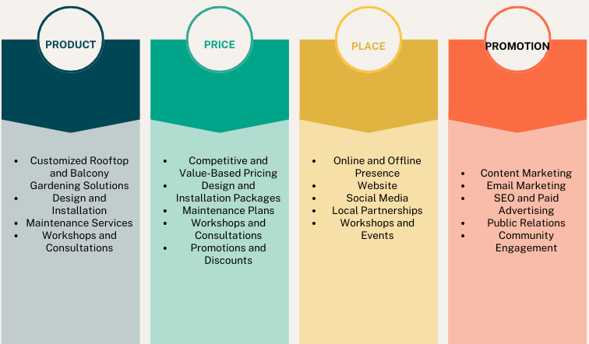


Slide 11
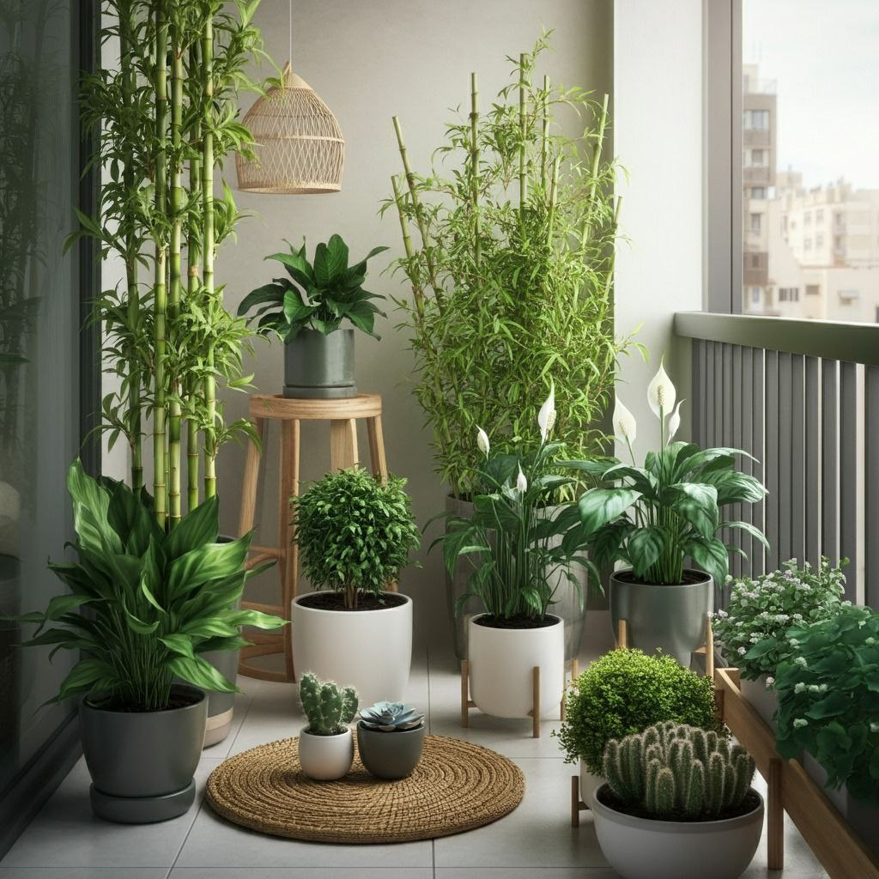
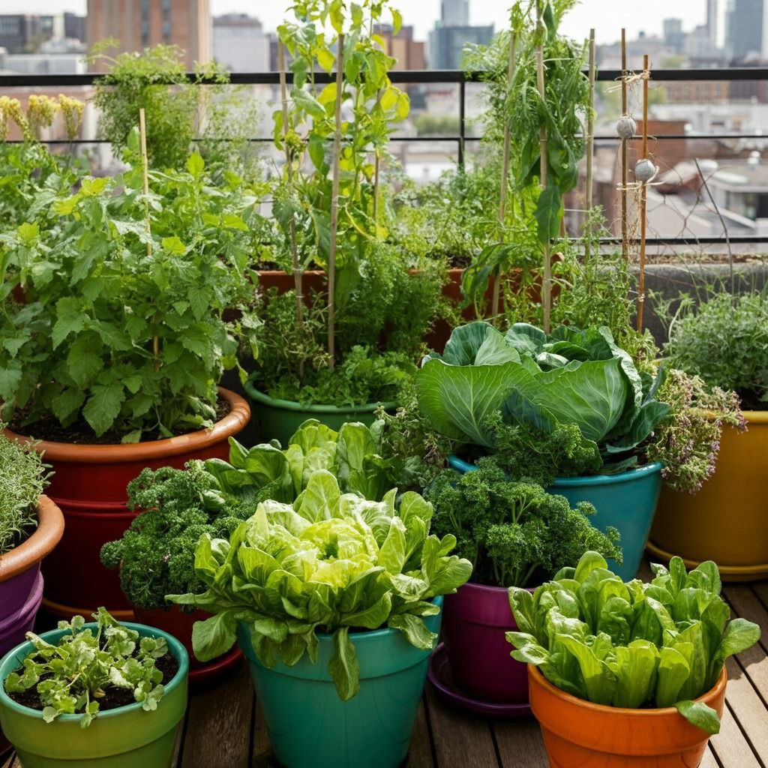
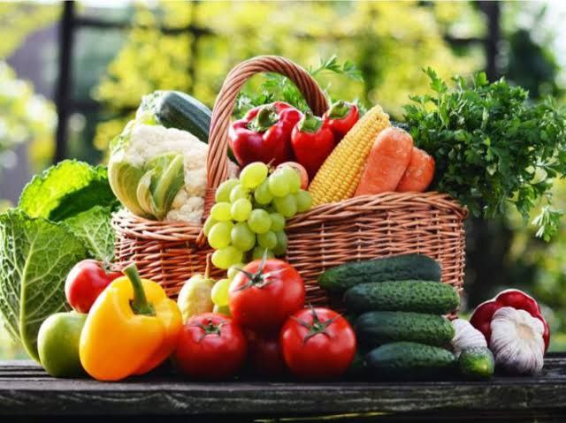
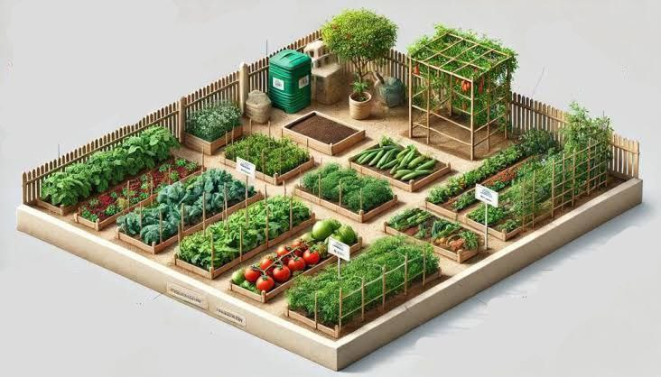
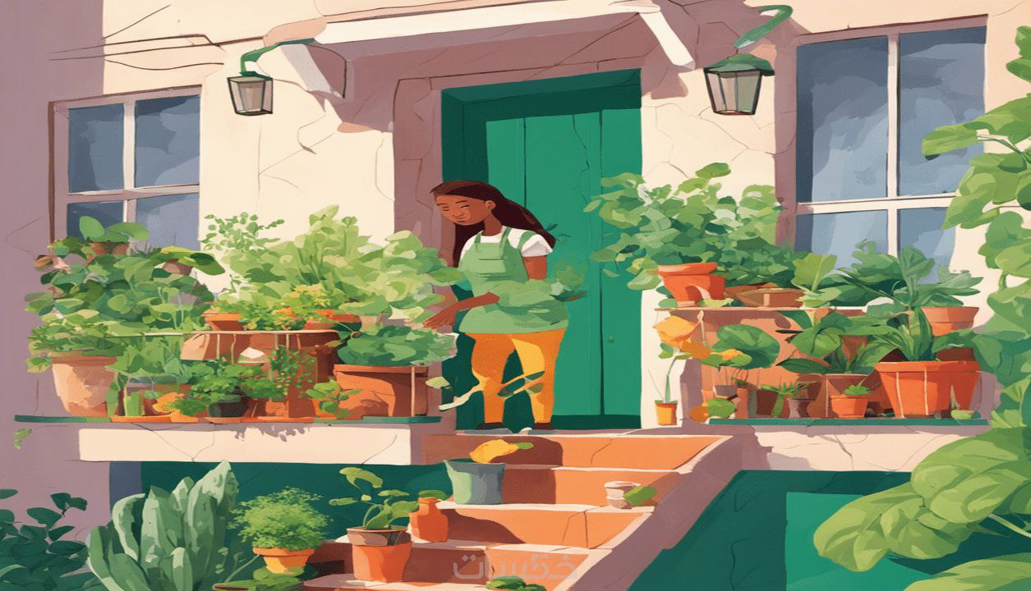
Our packages
decoration package
1500 LE/M2
herbs and leafy plants package
500 LE/M2
vegetables and fruits package
1000 LE/M2
typical and comprehensive package
2000 LE/M2
Green your space training Course 500 LE

Slide 12
Digital Marketing:
SEO: Optimize the website for relevant keywords to increase organic traffic.
Content Marketing: Create and share valuable content (blogs, videos, infographics) on gardening tips, sustainability, and project showcases.
Social Media: Engage with the audience on Instagram , and Facebook, through regular posts, stories, and interactive content.
Email Marketing: Send monthly newsletters with updates, promotions, and gardening advice.
Paid Advertising: Run targeted ads on Google and social media platforms to reach potential customers.
Traditional Marketing:
Print Ads: Place ads in local magazines and newspapers.
Events: Host workshops and participate in community events to build brand awareness.
Partnerships: Collaborate with local nurseries, home improvement stores, and environmental organizations

Slide 13
Social media content strategy
Posting frequency
Instagram
Posts and Reels: 3 times per week
Facebook
Posts and Stories: 3 times per week
Events/Live Videos: 2 times per month
YouTube
Videos: 1 times per week
Email Newsletters
Newsletters: 2 times per month

Slide 14

Content Calendar

Slide 15
 | item | who | when | How many | cost | objectives
1 | Facebook | m.hazem | October to December 2024 | 3 posts and Stories weekly | free to 500 LE | to get 1000 as minimum followers
2 | Instagram | mahmoud | October to December 2024 | 3 posts and reels weekly | free | to get 1000 as minimum followers
3 | YouTube And Creating videos to be attached to posts and ads | M. said | October to December 2024 | One video weekly | 1500 LE | To be short and attracted And to get 5000 as minimum views and subscription
4 | Email Newsletters and events | M. said | October to December 2024 | 4 times per month | free to 500 LE | to build brand awareness, and send promotions, and gardening advice
5 | Ads | m.hazem | October to December 2024 | Creating ad on facebook , instagram and youtube one of posts or videos 2 tims monthly | 1500 LE | Get affordable awareness and call to action to our website and social platforms
6 | Customer relation | mahmoud | October to December 2024 | Replying to our customer comments and emails daily | free | To respond to customer comments or emails through 30 minutes as maximum time
Actions

Slide 16
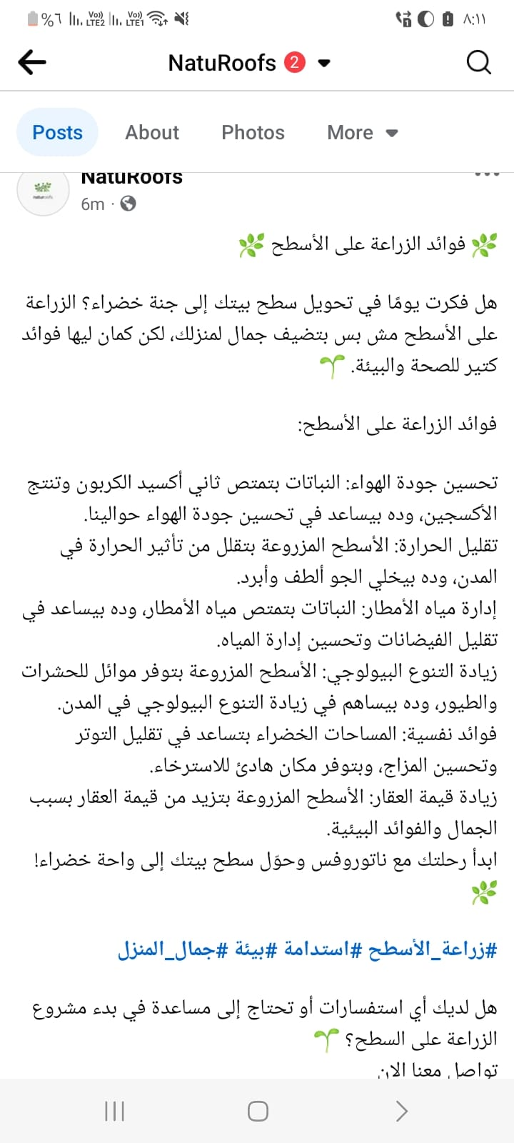
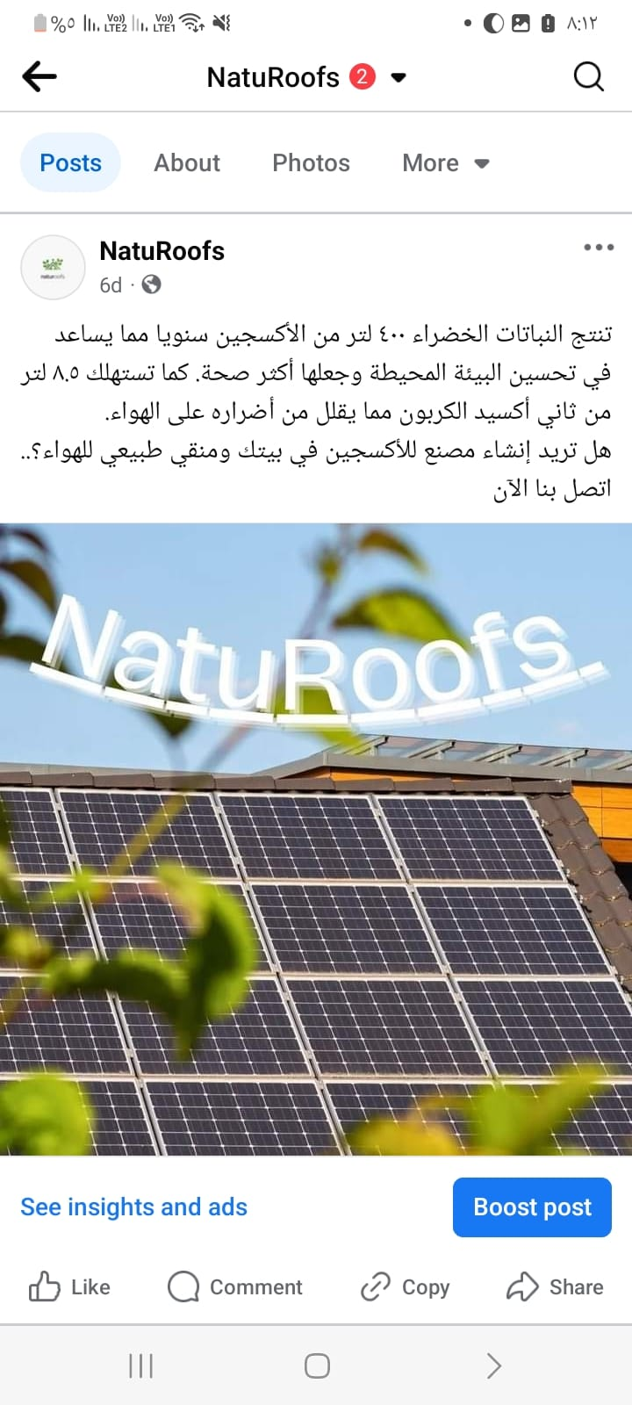

Facebook posts

Slide 17
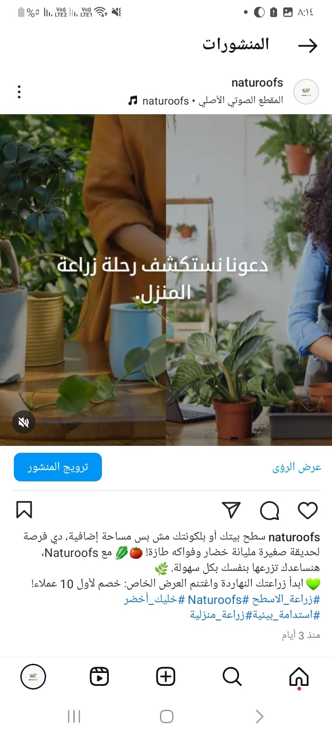
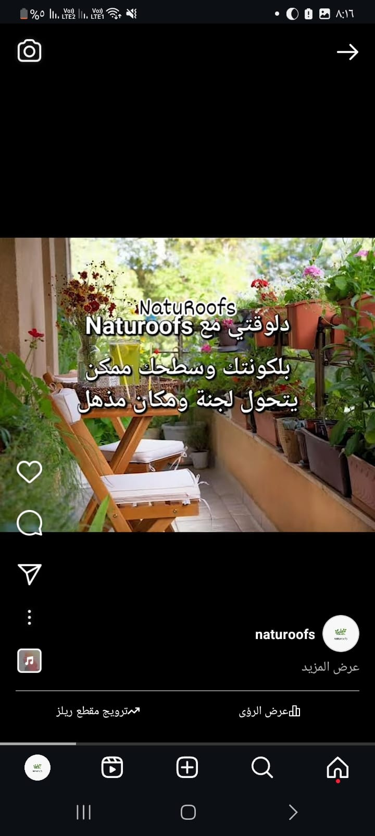
Instagram posts

Slide 18
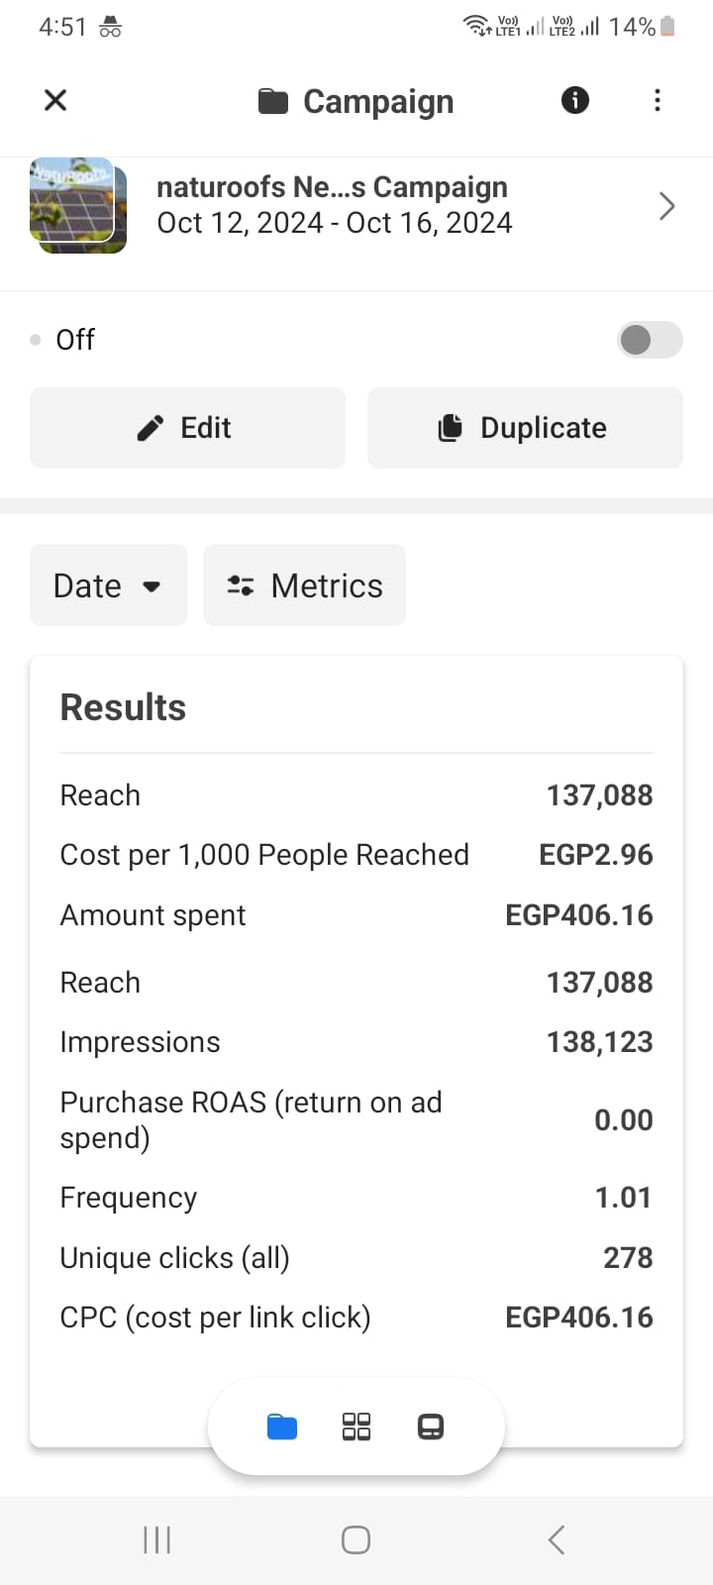
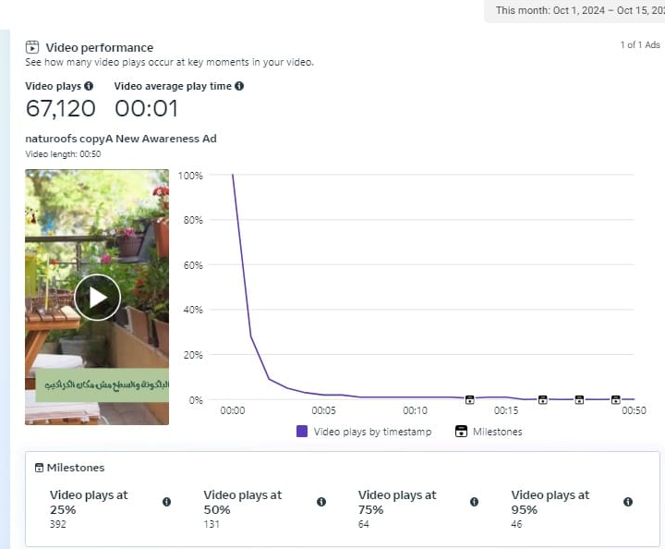
Facebook ads

Slide 19
Control
Marketing KPIs
Website Traffic
Metric: Number of unique visitors per month.
Goal: Increase website traffic by 30% over the next 6 months.
Lead Generation
Metric: Number of new leads generated through the website and social media.
Goal: Generate 100 new leads per month.
Conversion Rate
Metric: Percentage of website visitors who book a consultation or service.
Goal: Achieve a 10% conversion rate from website visitors to consultations.
Social Media Engagement
Metric: Number of likes, comments, shares, and followers on social media platforms.
Goal: Increase social media engagement by 50% over the next 3 months.
Email Open Rate
Metric: Percentage of recipients who open marketing emails.
Goal: Achieve a 25% open rate for email campaigns.

Slide 20
Social media marketing Monthly report
We have prepared this report for the first month based on analyzing data from advertising campaigns, social media performance, content evaluation, audience interactions and demographic data
The Engagement on Instagram, Facebook is low and not as targeted.
the most engagement of Content was with videos, mor than stories, images, and written posts.
The result of advertising camping on Facebook was not bad.., it was 137,088 reach throw 5 days only for 406 LE, But this doesn’t achieve our goal.
The audience age and gender were as targeted but location was limited to 3 cities out of 7, Cairo, Alexandria and Giza only.

Slide 21
Optimization
develop the social media pages and the website to be more professional.
Change the content strategy to be more effective in customer engagement.
Provide creative and attractive content.
Focus more on video content and improving it.
Increase the budget allocated for paid ads and to promote posts on Facebook and Instagram.
Focus on targeting customers in Cairo, Alexandria and Giza only due to the low cost and ease of access.
Regularly update and optimize website content based on keyword performance and search trends.

Slide 22

🌿 Naturoofs
we would 💚 to green your space 🌿
We appreciate your time and interest in Naturoofs. Together, we can create beautiful, sustainable green spaces that enhance urban living and contribute positively to the environment.
Let’s make our cities greener, one rooftop at a time.
Any questions?
hello@naturoofs.com
@naturoofs

